Slide 1
Digital Portfolio
STUDENT NAME: KAVIKA SRI M
REGISTER NO AND NMID: 2428B0322
DEPARTMENT: Bsc computer science with data analytics
COLLEGE: KPR collage of arts science and research

Slide 2
PROJECT TITLE
COMMUNITY SERVICES AND CONTRIBUTIONS

Slide 3


AGENDA
End Users
Problem Statement
Tools and Technologies
Portfolio design and Layout
Project Overview
Features and Functionality
Results and Screenshots
Conclusion
Github Link
3/21/2024 Annual Review

Slide 4

PROBLEM STATEMENT
Community service is essential for the overall growth and well-being
of society, but many individuals are unaware of its importance and the
impact of their contributions. Due to a lack of structured opportunities
and guidance, participation in such activities remains low.
This results in unequal sharing of responsibilities within communities,
where only a few people actively contribute while others remain uninvolved.
Consequently, the true potential of collective effort is not realized,
and end is slowed down.

Slide 5

PROJECT OVERVIEW
This project focuses on promoting community service and contributions by
creating awareness, encouraging participation, and providing structured
opportunities for individuals to get involved. It aims to highlight the importance
of collective responsibility in addressing social issues and
fostering development.Through planned activities, awareness campaigns,
and contribution drives,the project will motivate people to actively participate in
community growth. The ultimate goal to build a stronger, more responsible,
and supportive community.

Slide 6

WHO ARE THE END USERS?
Local Community Members – benefit directly from services and contributions.
Students and Youth – gain experience, skills, and social awareness.
Non-Governmental Organizations (NGOs) – receive support and resources for their initiatives.
Government and Local Bodies – collaborate to enhance community development.
Society as a Whole – experiences overall growth, harmony, and well-being.

Slide 7

TOOLS AND TECHNIQUES
Frontend: HTML, CSS, JavaScript for user-friendly interface.
Database: MySQL/SQLite to store user, contribution, and
feedback data.
Version Control: Git & GitHub for tracking and collaboration.
Presentation: Microsoft PowerPoint/Google Slides for project showcase.

Slide 8
POTFOLIO DESIGN AND LAYOUT
Visual Appeal – Use of colors, icons, and images to make it attractive.
Content Organization – Sections divided clearly (Introduction, Features, users, Outcomes, etc.).
Responsive Design – Ensures accessibility across devices (mobile, tablet, desktop).
Clean Layout – Simple and well-structured design for easy navigation
8

Slide 9
FEATURES AND FUNCTIONALITY
Awareness Creation – Conducts workshops, campaigns, and events to spread knowledge.
Volunteer Participation – Provides opportunities for students and citizens to contribute.
Resource Contribution – Allows donations of funds, materials, or skills.
Collaboration & Communication – Uses digital tools for coordination among members.
Impact Tracking – Collects feedback and measures results for improvement.
.

Slide 10

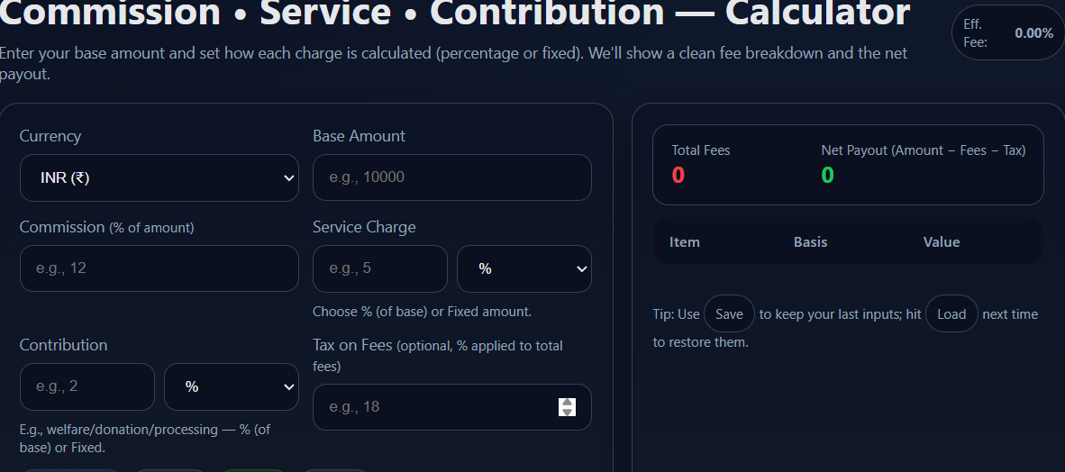
RESULTS AND SCREENSHOTS
Increased Awareness – More people understand the value of community service.
Active Participation – Higher involvement of students, youth, and local members.
Positive Community Impact – Visible improvements in social support and development.
3/21/2024 Annual Review
10

Slide 11
CONCLUSION
Community service and contribution are essential pillars for the growth and harmony of society.
This project highlights the importance of involving individuals, especially students and youth, in
activities that promote awareness, responsibility, and cooperation. By engaging in workshops,
campaigns, and volunteering, people not only contribute resources and time but also develop
valuable life skills such as leadership, teamwork, and empathy. The active participation of community
members, NGOs, and local bodies ensures that resources are shared effectively and the benefits
reach everyone. Ultimately, community service creates a culture of giving back, reduces social gaps,
and drives positive, long-lasting changes that uplift society as a whole.
11

Slide 12
GITHUB LINK:
https://kavikasri46.github.io/Kavika/

